Slide 1
Talk
The talk of each team is 8 min (about 4 - 6 slides) + 3 min questions. Each of the two members of each team has to do half of the talk.
Other than the report, the talk has to include an introduction so that your fellow students get the idea of your project..
The talk has to address the following points:
  topic and motivation
  methods used and what has been done so far
  first results
  next steps (at least two) until the end of the project
The report and presentation are done in workshop style, e.g., you present “the raw plots” of your work in progress and you are not investing too much time in perfect slides.

Slide 2
Time-optimal Flying a VTOL Drone
Leonardo Igler and Larissa Rickler

Slide 3
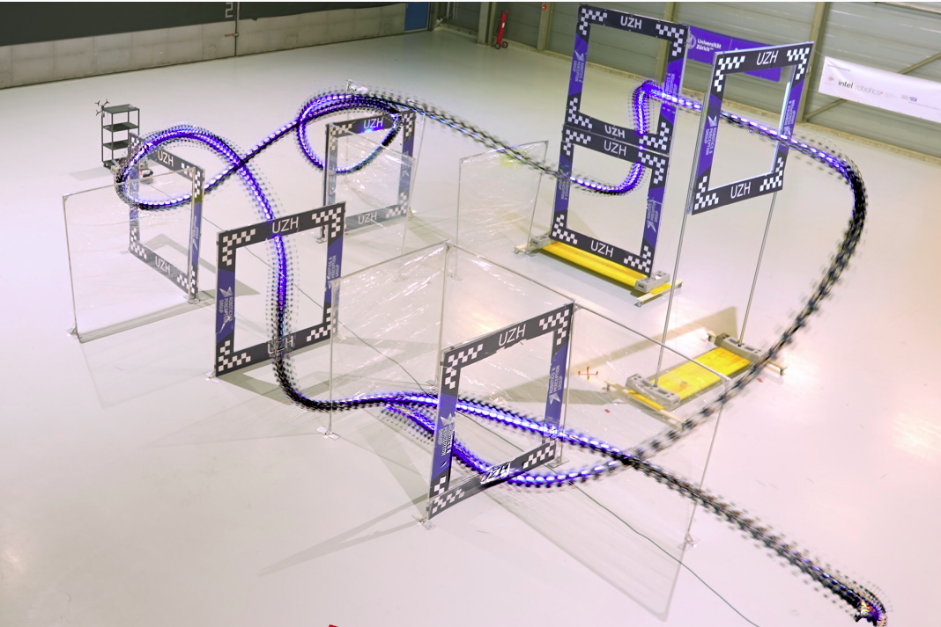
Topic and Motivation
Minimum-time flight for VTOL-Drone
Push platform to its limits
Use Cases:
Rescue
Delivery
Transportation
Fig. 1: Quadrotor races through a race track in the real world.

Slide 4
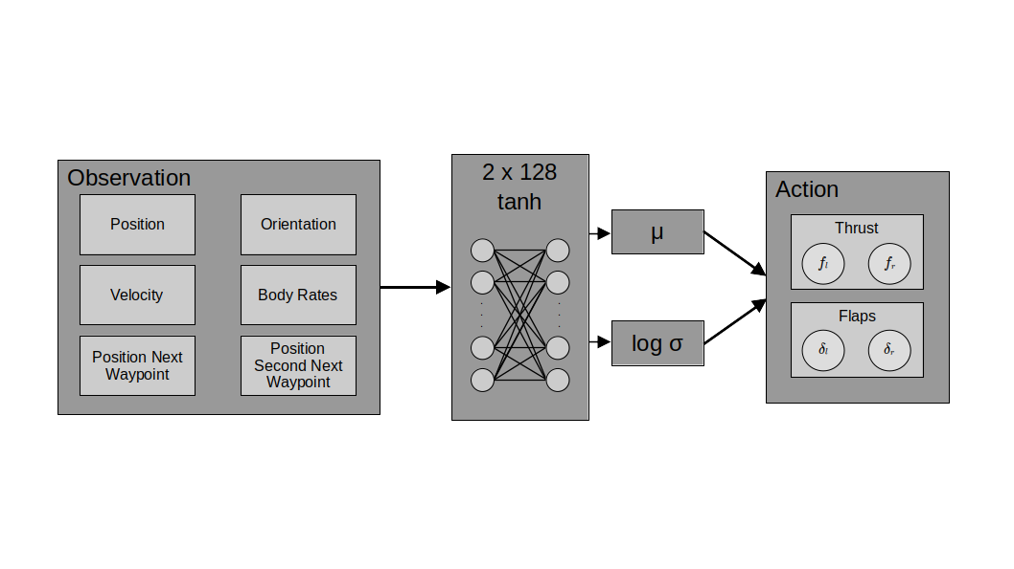
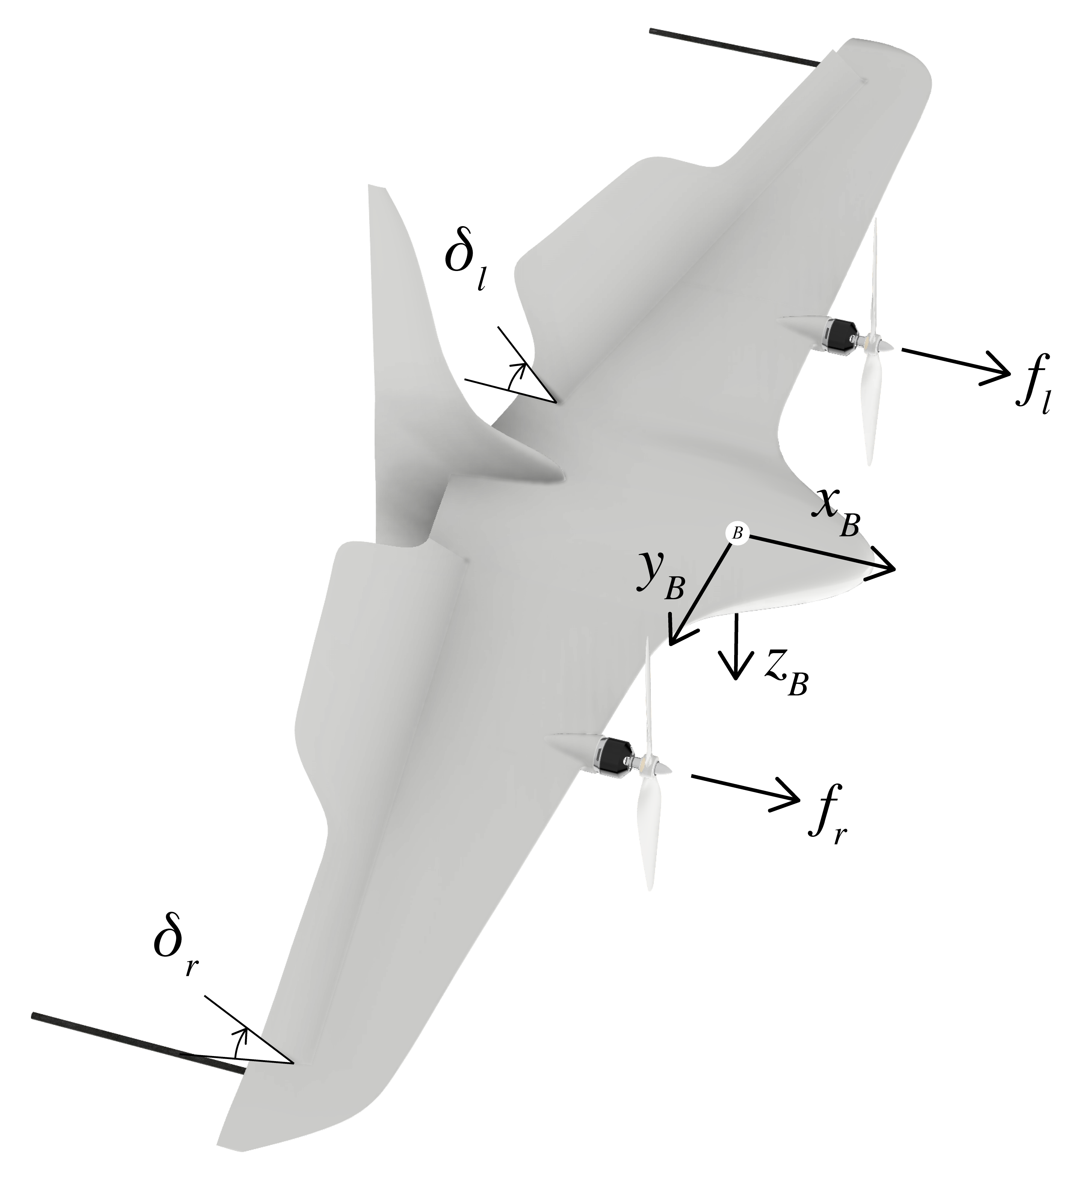
Our Approach
Actor Critic
Adam Optimizer

Slide 5
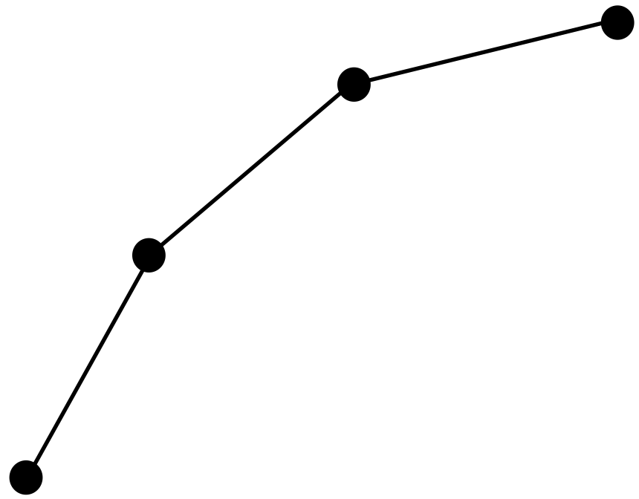
What has been done so far
Problem reduced to 2D
Steer towards single points
Fly along small random trajectories

Slide 6
Reward Function
Encourage line progression
Encourage reaching points
Penalize spinning
Penalize inactivity

Slide 7
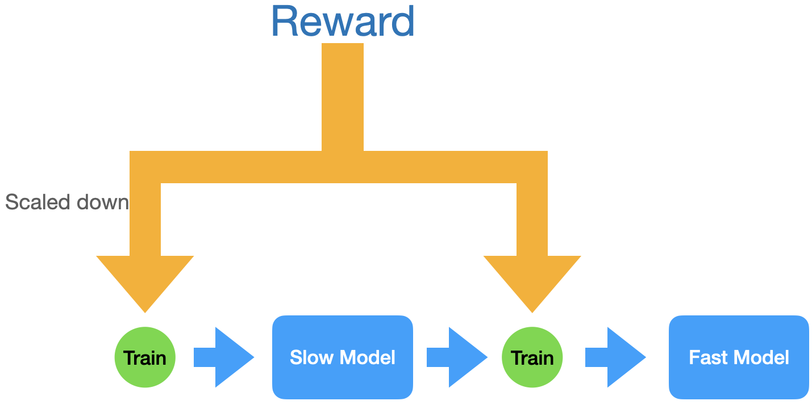
Training Strategy
Two Phases: Slow and Fast
Slow: Learn to follow path
Fast: Time optimality

Slide 8
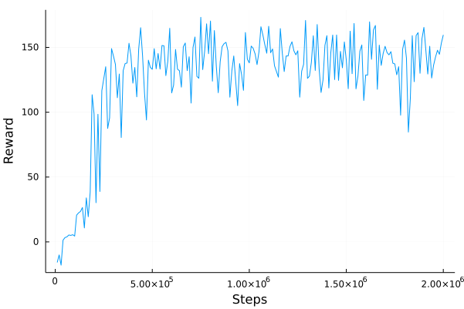
SLOW PLOTS

Slide 9
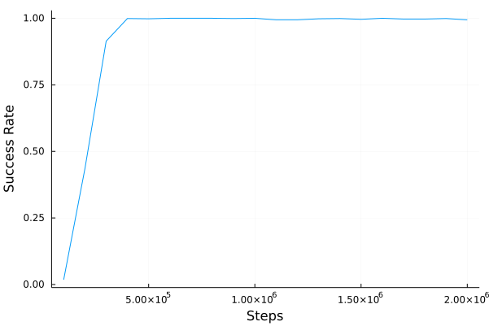
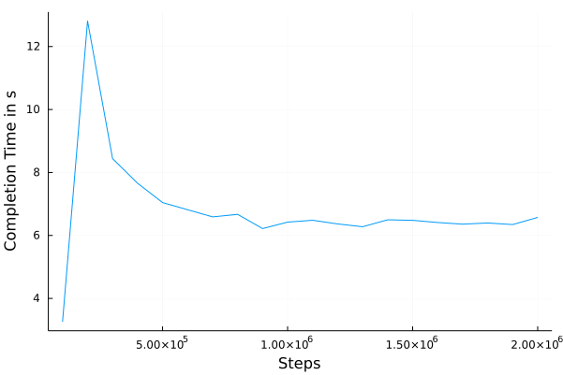
SLOW PLOTS

Slide 10
SLOW VIDEO
https://youtu.be/jzqBFTEnowo

Slide 11
FAST VIDEO
https://youtu.be/IRfzMXrSIUQ

Slide 12
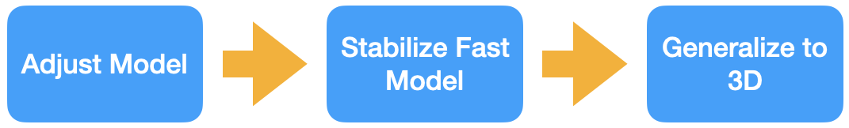
Next Steps

Slide 14
Appendix

Slide 15
Observation
Position
Velocity
2 x 128
tanh
1 x 128
Position next waypoint
.
.
.
μ
Action
.
.
.
.
.
.
Thrust
Orientation
fl
fr
log σ
Body Rates
1 x 128
Position second next waypoint
.
.
.
Actor

Slide 16
Observation
Position
Velocity
2 x 128
tanh
1 x 128
Position next waypoint
.
.
.
.
.
.
.
.
.
Orientation
Body Rates
Position second next waypoint
Critic

Slide 17
Reward Function
Encourage line progression in each step

Slide 18
Reward Function
Encourage line progression
  Counteracts to possible singularities in Δprogress

Slide 19
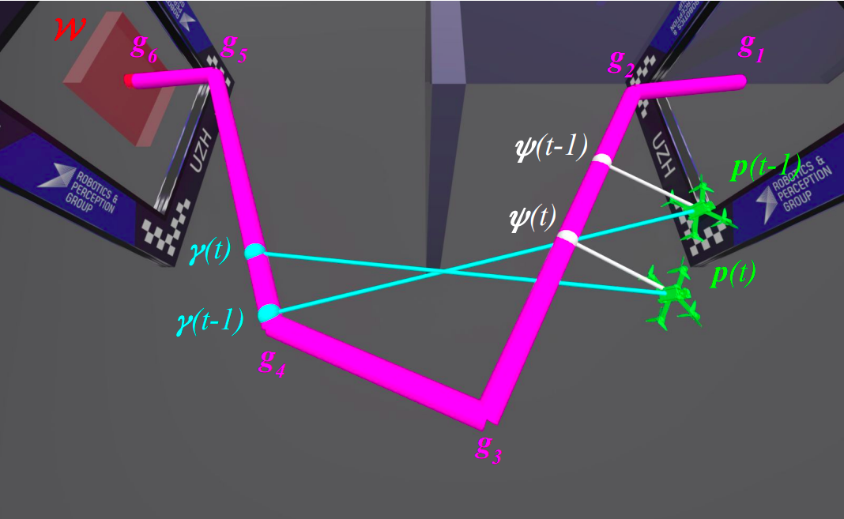
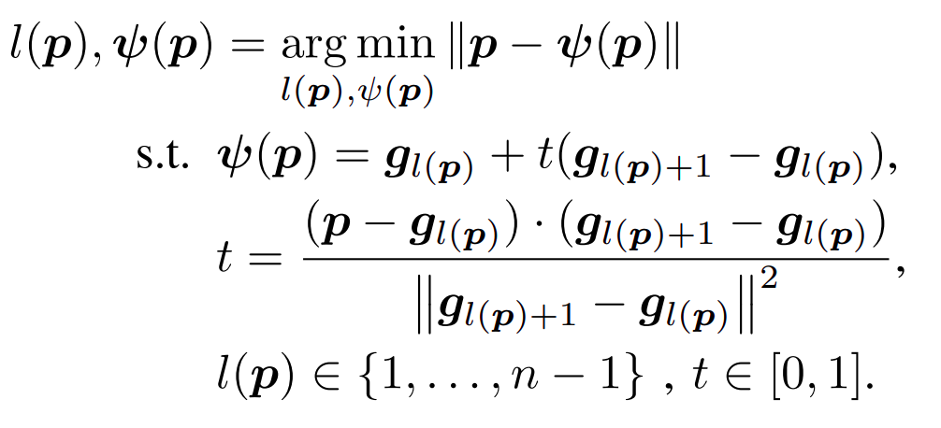
Reward Function
Progress calculation
Fig. 2: Illustration of guiding path between waypoints g. Nearest point on the guiding path ψ from drone position p is used to calculate progress reward rp(t) and rs(t) while the next and second next waypoints are used as a part of observation.

Slide 20
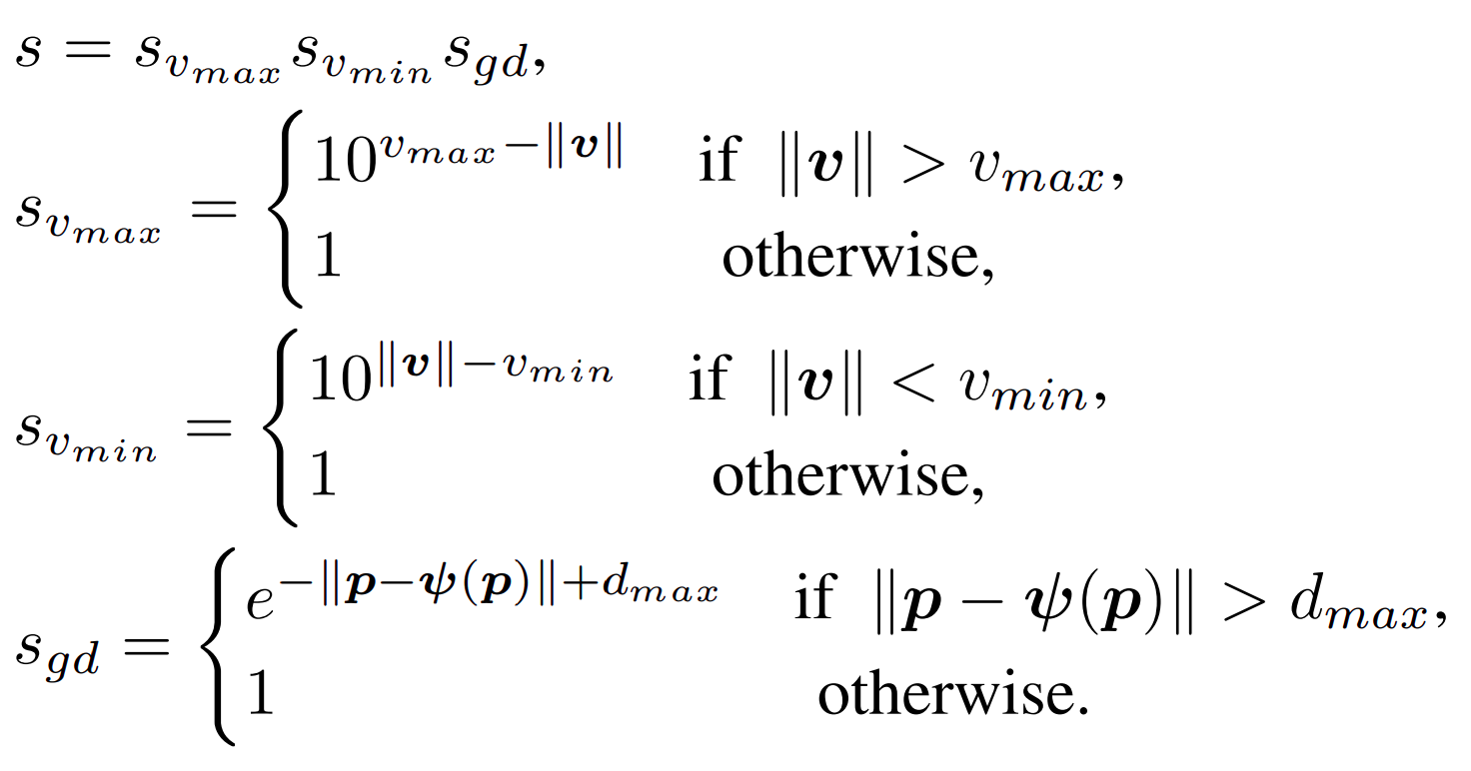
Reward Function
Scale down reward of progress.
Encourages velocity in certain range.

Slide 21
Reward Function
Encourage reaching points
  Only added if waypoint is passed within distance < disttol

Slide 22
Reward Function
Penalize spinning

Slide 23
Reward Function
Penalize inactivity
  Only subtracted if hight falls under -2
fall = 1

Slide 24
Termination Criteria
Body rates to high
Velocity to high
Drone falls below -5
Too much time passed
Too far off path
All waypoints reached

Slide 25
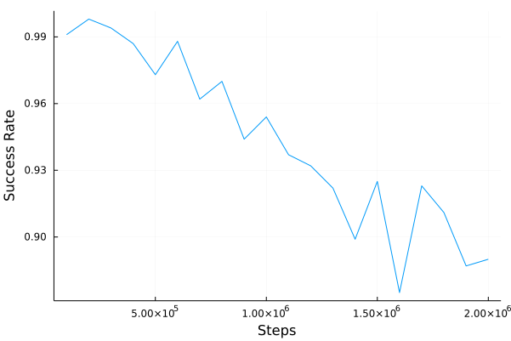
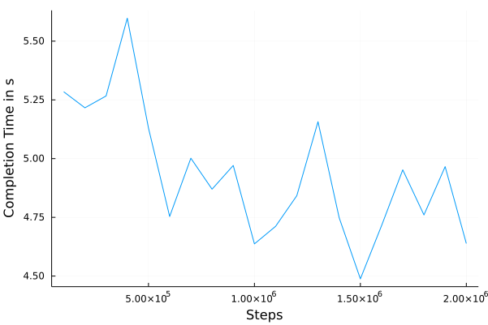
FAST PLOTS

Slide 26
Image Sources
From https://arxiv.org/pdf/2203.15052v1.pdf
Fig. 1: Our quadrotor races through a complex race track inthe real world.
Fig. 2: Illustration of guiding path between waypoints g. Nearest point on the guiding path ψ from drone position p is used to calculate progress reward rp(t) and rs(t) while the next and second next waypoints are used as a part of observation.
https://arxiv.org/pdf/2203.15052v1.pdf

Slide 27
What has been done so far
2D
  Flight to one fix point
  Flight to random point
  Slow flight on random trajectory
  Fast flight on random trajectory

Slide 28
Next Steps
Adjust network architecture
Stabilize fast flight in 2D
Generalize achievements to 3D
  Adjust observation and action space
  Adjust network architecture for 3D
  (Optional: change drone model to quadrotor)

